Slide 1

Conflict data: have conflicts changed over time?
By Anastatios, erin, madhi, Mitch

Slide 2
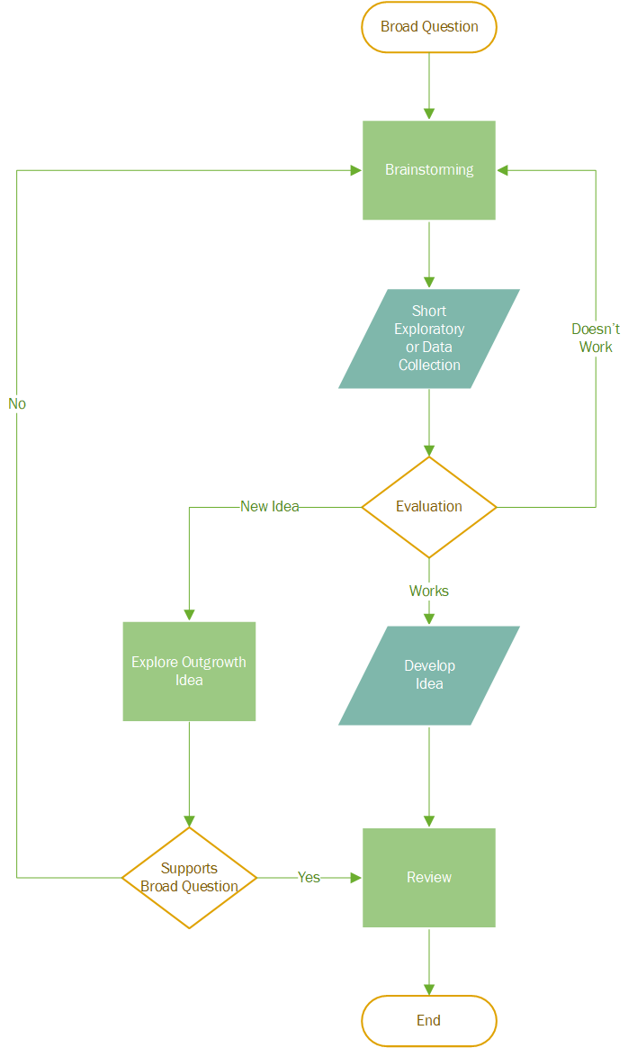
Idea Generation

Slide 3
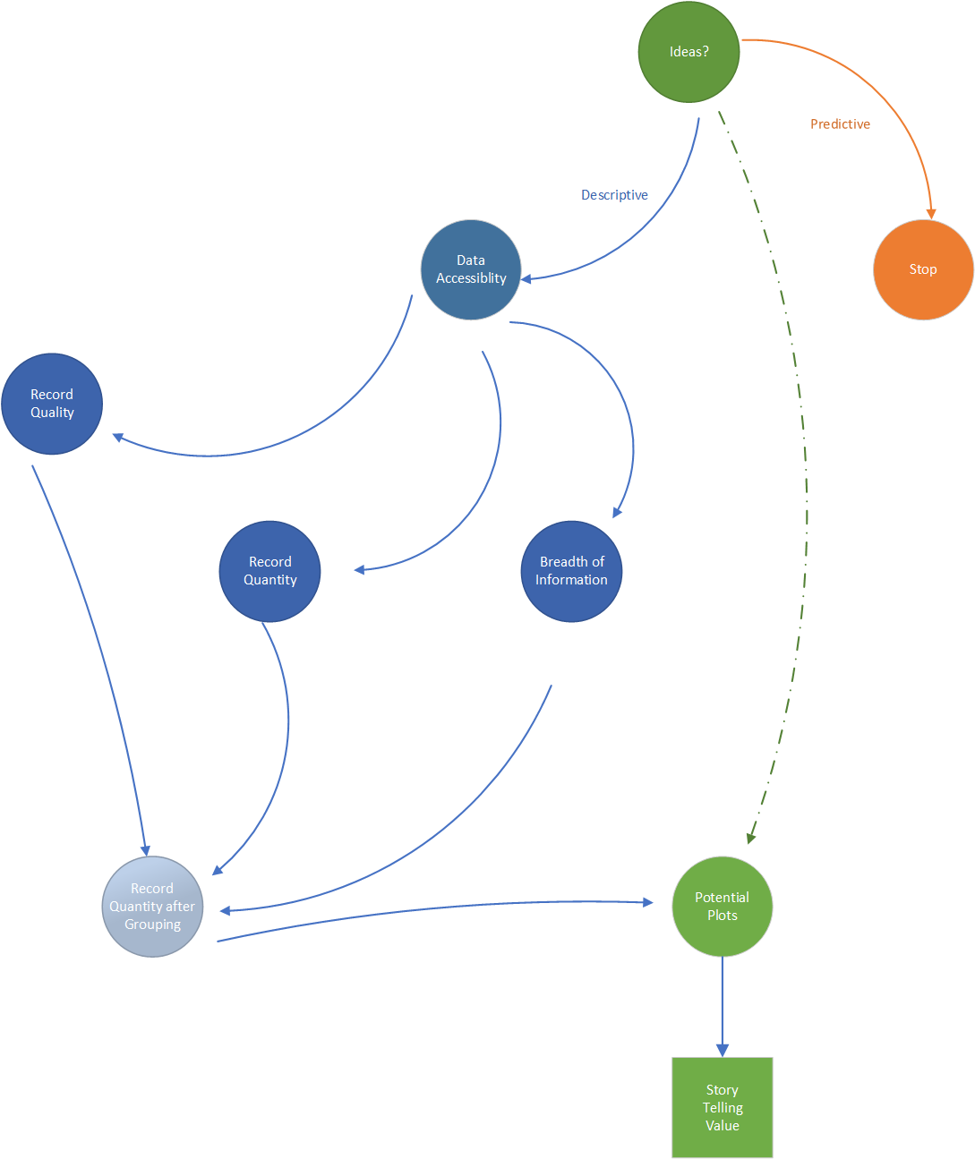
Project selection

Slide 4
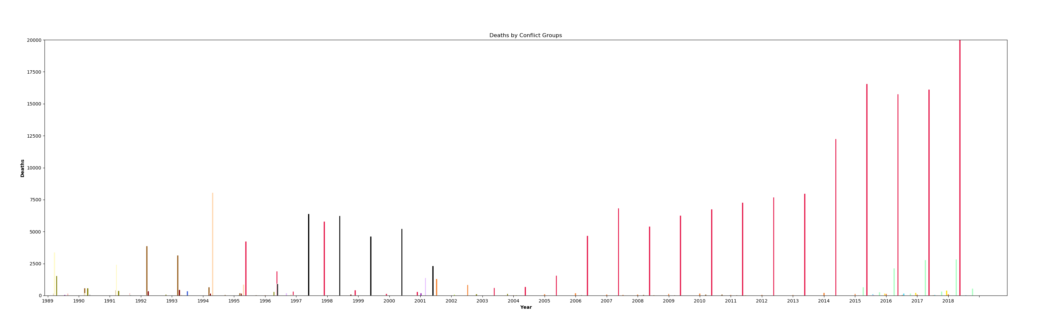
Deaths between groups

Slide 5
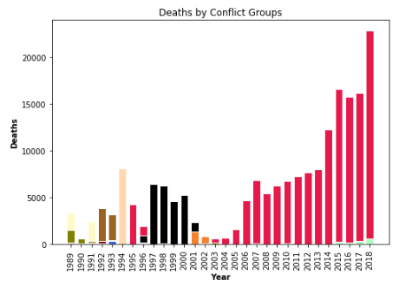

Slide 6
Groups in Conflict | Deaths (1989 – 2018)
Government of Afghanistan and Taleban | 24,077
Government of Afghanistan and IS | 1,289
Civilians and Taleban | 922
Government of Afghanistan and UIFSA | 911
Government of Afghanistan and Hizb-i Islami-yi Afghanistan | 302
Government of Afghanistan and Junbish-i Milli-yi Islami | 254
Government of United States of America and al-Qaida | 202
Civilians and Government of Afghanistan | 138
Government of Afghanistan and Hizb-i Islami-yi Afghanistan - Khalis faction | 138
IS and Taleban | 136
Government of Afghanistan and Government of United Kingdom, Government of United States of America | 100
Government of Afghanistan and Jam'iyyat-i Islami-yi Afghanistan | 81
Government of Afghanistan and Hizb-i Wahdat | 80
Civilians and IS | 70
Jam'iyyat-i Islami-yi Afghanistan and Junbish-i Milli-yi Islami | 69
28 Other Groups of 50 Deaths or fewer (Only 8 Deaths related to Government of Afghanistan) | 160

